Slide 1
K-means 3-D Clustering
Sunday, 11/12/2017
Regimes classification with pCO2, sea-surface temperature, and wind speed

Slide 2
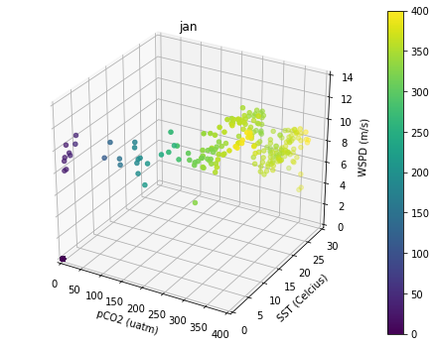

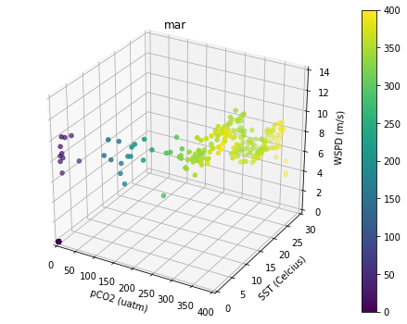
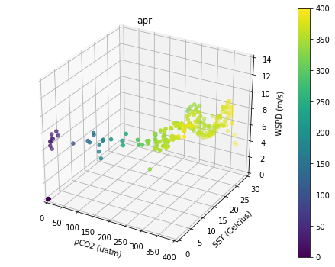
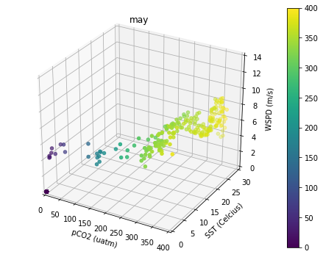
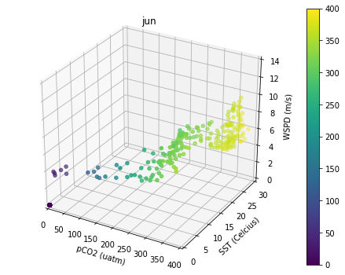
Classification Input: Monthly 3D Scatterplots
Sunday, 11/19/2017
Notes:
color scheme is based on the pCO2 level.
each dot represents a single data point, with measurement of pCO2, WSPD, and SST at a particular month.

Slide 3

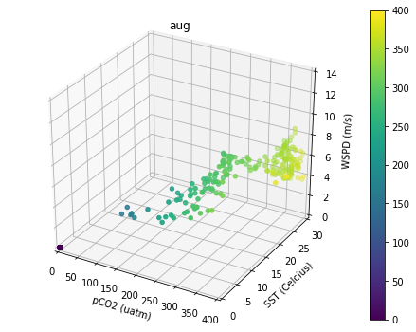
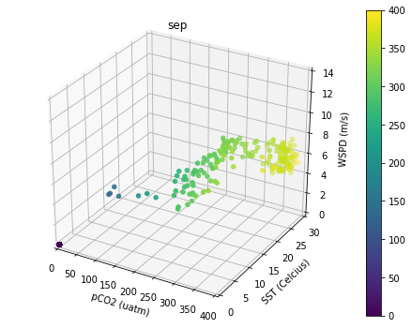
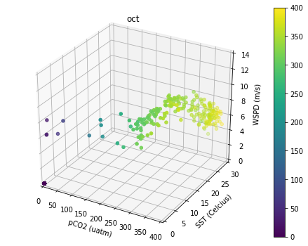
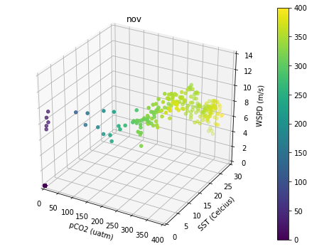
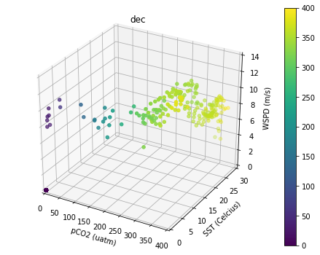
Classification Input: Monthly 3D Scatterplots
Sunday, 11/19/2017

Slide 4
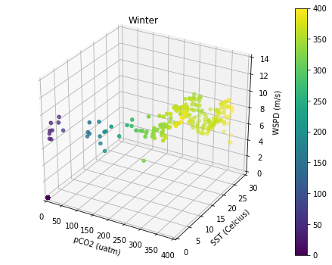
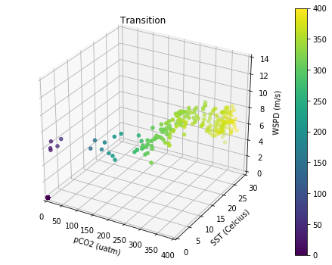

Three-Season K-means Result
Sunday, 11/19/2017
Average months are classified into 3 clusters:
winter
summer
transitional
Jan
Feb
Mar
Apr
May
Jun
Jul
Aug
Sep
Oct
Nov
Dec
Scatterplots with pCO2, sea-surface temperature, and wind speed:
Notes:
In this case, “convergence” can describe the moment when an iterative computation of means for all clusters stay the same.
More about clustering k-means library: http://scikit-learn.org/stable/modules/generated/sklearn.cluster.KMeans.html

Slide 5
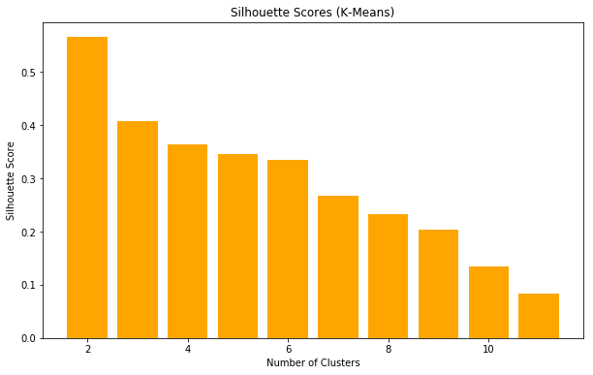
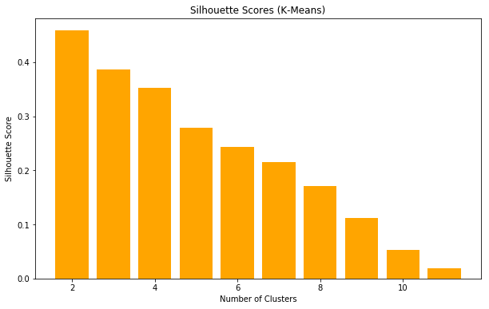
K-Means Silhouette Score
Sunday, 11/19/2017
2-D Clustering
3-D Clustering
Choose k intuitively where k results in the most decline to k+1.
In this case, we can consider k = 4 for 3-D clustering.
Notes:
http://scikit-learn.org/stable/modules/generated/sklearn.metrics.silhouette_score.html

Slide 6



Four-Season K-means Result
Sunday, 11/19/2017
Average months are classified into 3 clusters:
winter
spring
summer
fall
Jan
Feb
Mar
Apr
May
Jun
Jul
Aug
Sep
Oct
Nov
Dec
Scatterplots with pCO2, sea-surface temperature, and wind speed:
Notes:
In this case, “convergence” can describe the moment when an iterative computation of means for all clusters stay the same.

Slide 7
Color-scale with Wind Speed
Sunday, 11/12/2017
Clustering with 3-Dimensional Data

Slide 8
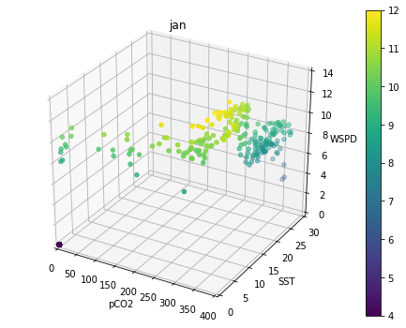
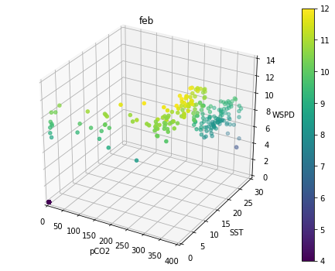
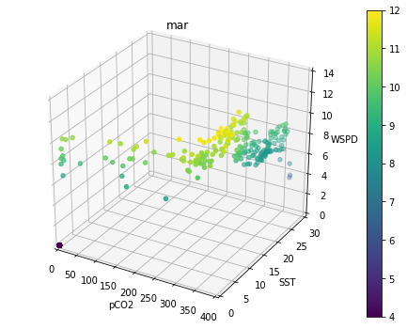
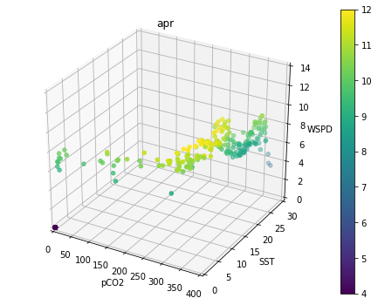
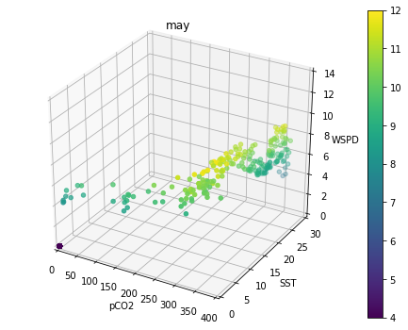
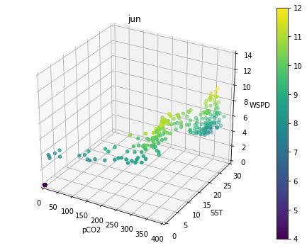
Classification Input: Monthly 3D Scatterplots
Tuesday, 11/14/2017

Slide 9
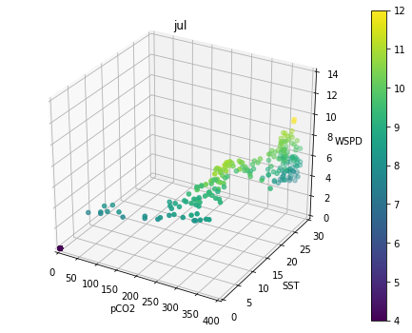
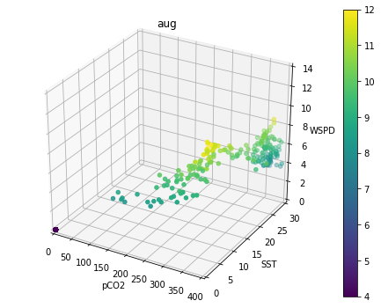
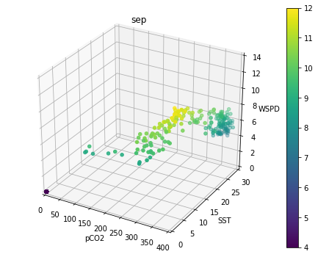
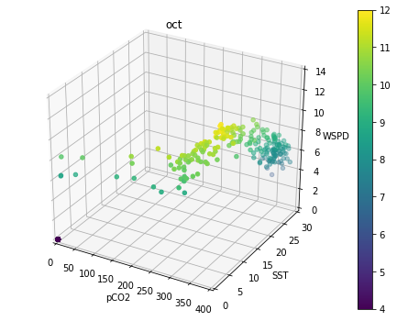
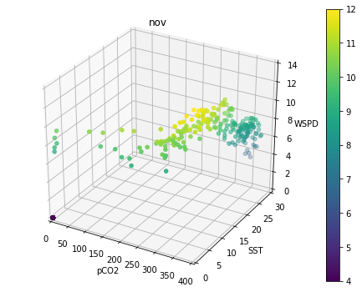
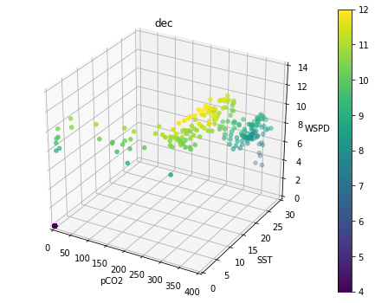
Classification Input: Monthly 3D Scatterplots
Tuesday, 11/14/2017

Slide 10
Histogram as Classification Input
Sunday, 11/12/2017
Clustering with 3-Dimensional Data

Slide 11
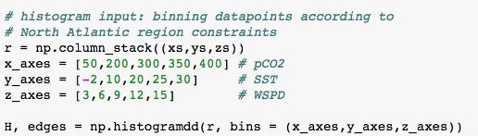
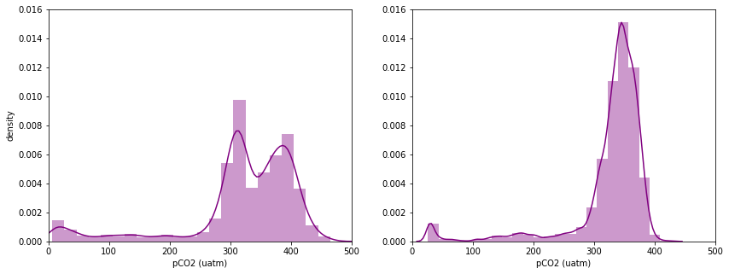
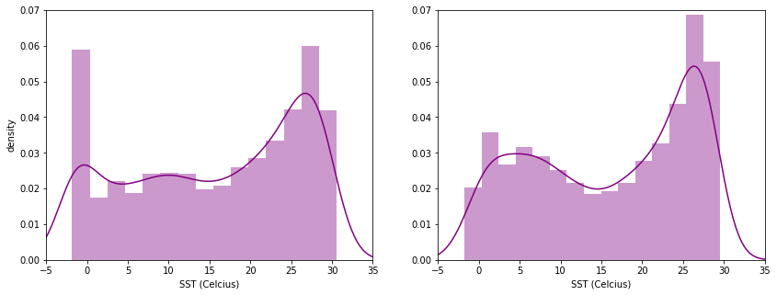
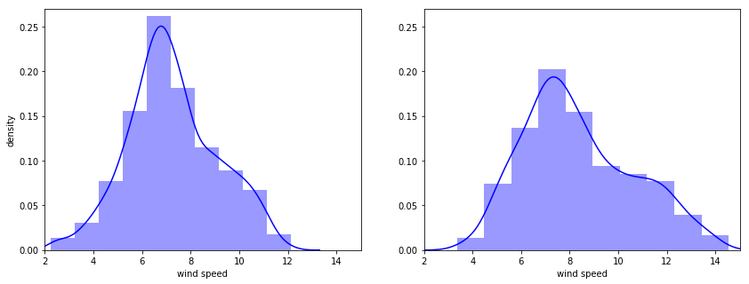
Binning data points based on variables PDD
Sunday, 11/26/2017
Define bins (4 per axis):
pCO2 PDD for x-axis
SST PDD for y-axis
WSPD PDD for z-axis
Notes:
In this case, “convergence” can describe the moment when an iterative computation of means for all clusters stay the same.
More about clustering k-means library: http://scikit-learn.org/stable/modules/generated/sklearn.cluster.KMeans.html

Slide 12
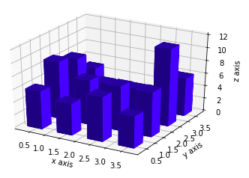
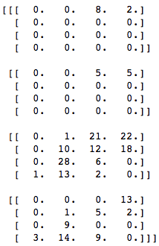
3D Histogram: Bar plots implication
Sunday, 11/26/2017
Example of 4x4x4 array for 3D histogram input on a single month:
Can’t use the following 3D histogram because then z-axis would be replaced by the frequency of x- and y-axes.
All data points on the first Y-bin
All data points on the first X-bin
All data points on the second Z-bin
ie. this bar may represent the frequency of datapoints that fall into the first x-bin (between 0 and 1) and the first y-bin (between 0 and 1), but not necessarily showing z-axis.
Solution: To plot the three axes, we have to plot in points/dots (ie. using scatterplots). To identify the frequency of three points happening, we can use either color or size in each dot.
Notes:
In this case, “convergence” can describe the moment when an iterative computation of means for all clusters stay the same.
More about clustering k-means library: http://scikit-learn.org/stable/modules/generated/sklearn.cluster.KMeans.html

Slide 13
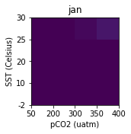
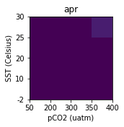
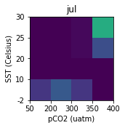
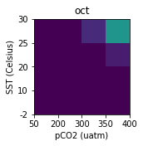


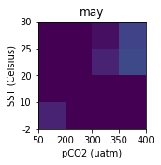
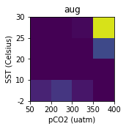
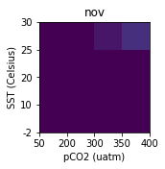

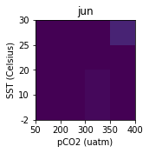
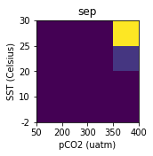

Wind Speed Bin #1: 3-6 m/s
Tuesday, 11/14/2017

Slide 14
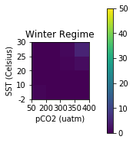
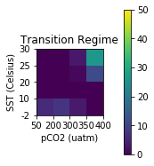
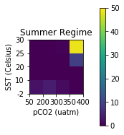
Bin #1 K-means Result with Wind Speed 3-6 m/s
Sunday, 11/19/2017
Average months are classified into 3 clusters:
winter
summer
transitional
Jan
Feb
Mar
Apr
May
Jun
Jul
Aug
Sep
Oct
Nov
Dec
2-D histogram with pCO2 and sea-surface temperature:
Notes:
In this case, “convergence” can describe the moment when an iterative computation of means for all clusters stay the same.
More about clustering k-means library: http://scikit-learn.org/stable/modules/generated/sklearn.cluster.KMeans.html

Slide 15
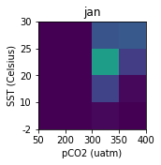
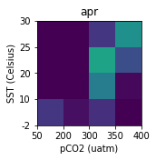
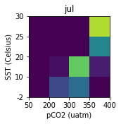
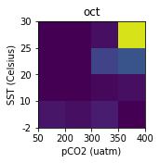
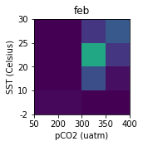
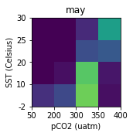






Wind Speed Bin #2: 6-9 m/s
Tuesday, 11/14/2017

Slide 16



Bin #2 K-means Result with Wind Speed 6-9 m/s
Sunday, 11/19/2017
Average months are classified into 3 clusters:
winter
summer
transitional
Jan
Feb
Mar
Apr
May
Jun
Jul
Aug
Sep
Oct
Nov
Dec
2-D histogram with pCO2 and sea-surface temperature:
Notes:
In this case, “convergence” can describe the moment when an iterative computation of means for all clusters stay the same.
More about clustering k-means library: http://scikit-learn.org/stable/modules/generated/sklearn.cluster.KMeans.html

Slide 17



Bin #2 K-means Result with Wind Speed 6-9 m/s
Sunday, 11/19/2017
Average months are classified into 4 clusters:
winter
spring
summer
fall
Jan
Feb
Mar
Apr
May
Jun
Jul
Aug
Sep
Oct
Nov
Dec
2-D histogram with pCO2 and sea-surface temperature:
Notes:
In this case, “convergence” can describe the moment when an iterative computation of means for all clusters stay the same.

Slide 18











Wind Speed Bin #3: 9-12 m/s
Tuesday, 11/14/2017

Slide 19



Bin #3 K-means Result with Wind Speed 9-12 m/s
Sunday, 11/19/2017
Average months are classified into 3 clusters:
winter
summer
transitional
Jan
Feb
Mar
Apr
May
Jun
Jul
Aug
Sep
Oct
Nov
Dec
2-D histogram with pCO2 and sea-surface temperature:
Notes:
In this case, “convergence” can describe the moment when an iterative computation of means for all clusters stay the same.
More about clustering k-means library: http://scikit-learn.org/stable/modules/generated/sklearn.cluster.KMeans.html

Slide 20












Wind Speed Bin #4: 12-15 m/s
Tuesday, 11/14/2017

Slide 21



Bin #4 K-means Result with Wind Speed 12-15 m/s
Sunday, 11/19/2017
Average months are classified into 3 clusters:
winter
summer
transitional
Jan
Feb
Mar
Apr
May
Jun
Jul
Aug
Sep
Oct
Nov
Dec
2-D histogram with pCO2 and sea-surface temperature:
Notes:
In this case, “convergence” can describe the moment when an iterative computation of means for all clusters stay the same.
More about clustering k-means library: http://scikit-learn.org/stable/modules/generated/sklearn.cluster.KMeans.html

Slide 22
Per-Bin Classification vs.
All-Bins Classification
Friday, 12/8/2017
(4x4x4) x 12 as classification input

Slide 23
Classification using (4x4x4) x 12 month histogram input
Friday, 12/8/2017
Average months are classified into 3 clusters:
winter
summer
transitional
Jan
Feb
Mar
Apr
May
Jun
Jul
Aug
Sep
Oct
Nov
Dec
Notes:
In this case, “convergence” can describe the moment when an iterative computation of means for all clusters stay the same.
More about clustering k-means library: http://scikit-learn.org/stable/modules/generated/sklearn.cluster.KMeans.html

Slide 24



Using per-bin classification
Rebecca’s Regimes
WSPD 3-6m/s
WSPD 6-9m/s
WSPD 9-12m/s
WSPD 12-15m/s
Notes:
In this case, “convergence” can describe the moment when an iterative computation of means for all clusters stay the same.
More about clustering k-means library: http://scikit-learn.org/stable/modules/generated/sklearn.cluster.KMeans.html

Slide 25












Using all-bins classification
Rebecca’s Regimes
WSPD 3-6m/s
WSPD 6-9m/s
WSPD 9-12m/s
WSPD 12-15m/s
Notes:
In this case, “convergence” can describe the moment when an iterative computation of means for all clusters stay the same.
More about clustering k-means library: http://scikit-learn.org/stable/modules/generated/sklearn.cluster.KMeans.html

Slide 26
Attempt on 3-D Binned Scatterplots
Sunday, 11/12/2017
With pCO2, SST, and Wind Speed variables

Slide 27






Classification Input: Binned 3D monthly data
Notes:
color scheme is based on the pCO2 level.
each dot represents a single data point, with measurement of pCO2, WSPD, and SST at a particular month.

Slide 28






Classification Input: Binned 3D monthly data

